Slide 1
Big Data Technologies
Final project
Kim Bang Le- 986999

Slide 2
Agenda
Objectives
Project introduction
Architecture
Big data technologies used
Instructions
Demo

Slide 3
Project Objectives
Apply big data technologies learned in this course into real project
Research new big data technologies
Solve a real problem using big data technologies

Slide 4
Project introduction
Original/planned solved problem:
Extract data from twitter to see what US people are discussing/thinking about Trump and Biden
From the extracted data, there will be another step to analyze them and see Trump or Biden who will have more chance to win the 2020 election.
Unsolved issue: there is bug and cannot extract data from Twitter
Problem is implemented
Generate/Read a stream of numbers and analyze/classify which one is even/odd number

Slide 5





Architecture
Original/planned solved problem
Problem is implemented/solved
producer
Twitter
producer

Slide 6
Architecture (cont.)
There are 2 Java based projects
Producer project
Generate/extract data from source and output to Kafka
Play the role as Kafka producer
Consumer project
Read data from Kafka using Spark streamming
Analyze data
Output to Hbase
Play the role as Kafka consumer

Slide 7
Big Data Technologies used
Spark Streamming
Hbase
Kafka
Others: Twitter API

Slide 8
Instructions
Start Kafka
KAFKA_HOME=/home/cloudera/kafka_2.12-2.6.0; export KAFKA_HOME
//Start Zookeeper server
$KAFKA_HOME/bin/zookeeper-server-start.sh $KAFKA_HOME/config/zookeeper.properties
//Start Kafka server
$KAFKA_HOME/bin/kafka-server-start.sh $KAFKA_HOME/config/server.properties
Create a topic
//Create a topic
$KAFKA_HOME/bin/kafka-topics.sh --create --zookeeper localhost:2181 --replication-factor 1 --partitions 1 --topic KafkaData
Test Kafka with Kafka producer and consumer
//Send some messages
$KAFKA_HOME/bin/kafka-console-producer.sh --broker-list localhost:9092 --topic KafkaData
//Start a consumer
$KAFKA_HOME/bin/kafka-console-consumer.sh --bootstrap-server localhost:9092 --topic KafkaData --from-beginning

Slide 9
Instructions (cont.)
Start consumer application
spark-submit --class "bangle.cs523.SparkStreamProj.App" --master yarn /home/cloudera/FinalProject/SparkStreamProj/target/SparkStreamProj-0.0.1-SNAPSHOT.jar
Start producer application
spark-submit --class "bangle.cs523.KafkaProducer.App" --master yarn /home/cloudera/FinalProject/KafkaProducer/target/KafkaProducer-0.0.1-SNAPSHOT.jar
Check Hbase for result

Slide 10
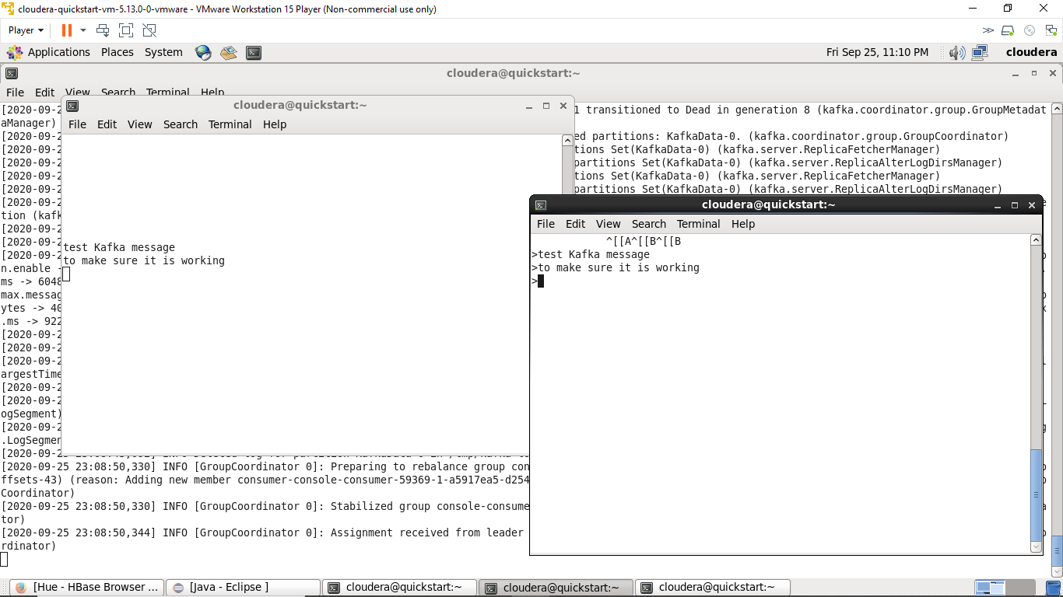
Demo
Start Kafka server and test Kafka with Kafka producer and consumer

Slide 11
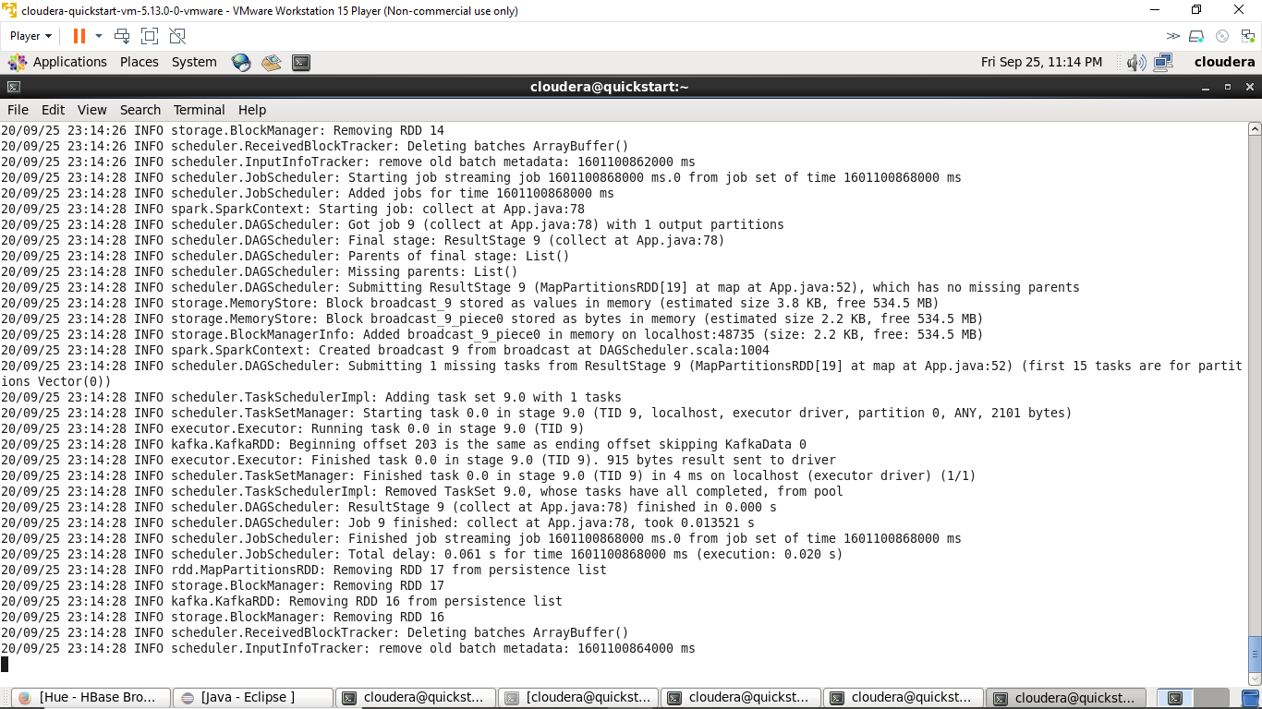
Demo (cont.)
Start Consumer application

Slide 12
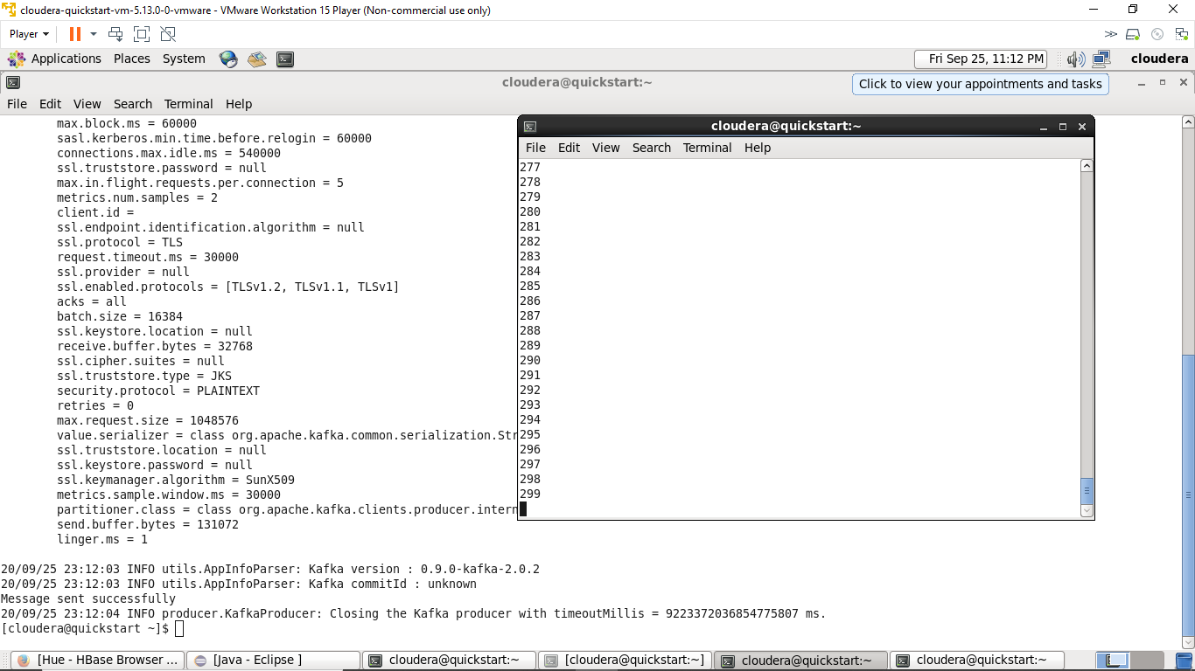
Demo (cont.)
Start Producer application and check Kafka consumer for generated numbers

Slide 13
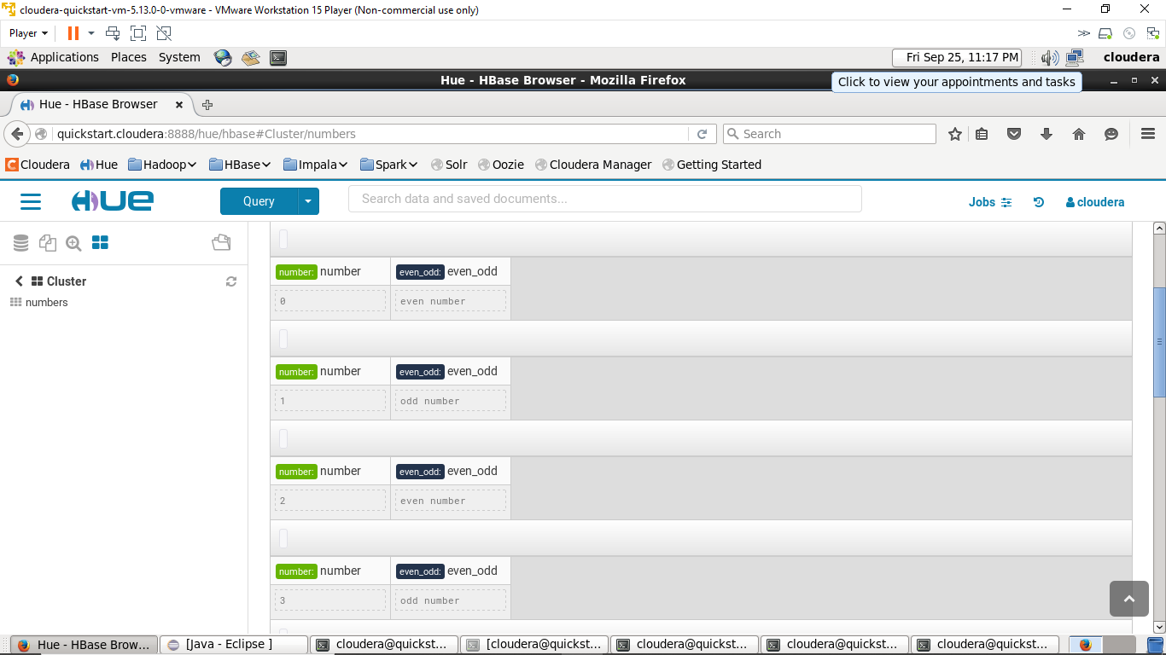
Demo (cont.)
Check result in HBase

Slide 14
Coveraged Requirements
Project Parts | Short Description | Notes
1 | Spark Streaming Project | SparkStreamProj project
2 | Spark and HBase Integration | SparkStreamProj project
3 | Additional small research project | Integrated with Kafka in both projects
4 | Video recording of project demo | Link to video will be provided

Slide 15
Thank You

